Slide 1
Finite Mixture Models
(Probability Based Clustering)

Slide 2
Motivation
Up until this point, we have dealt with hard clustering.
Something is either in or not in a given cluster.
This methodology works well, but does not necessarily always make sense -> What do we do when we have one tight cluster and one dispersed cluster?

Slide 3
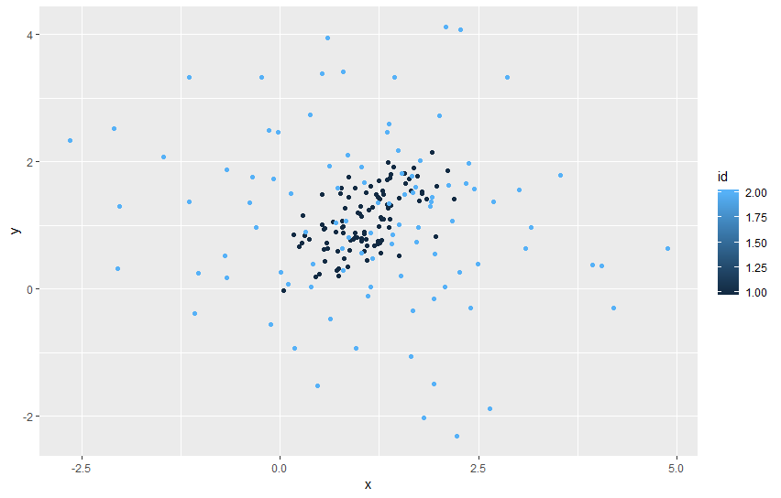

Slide 4
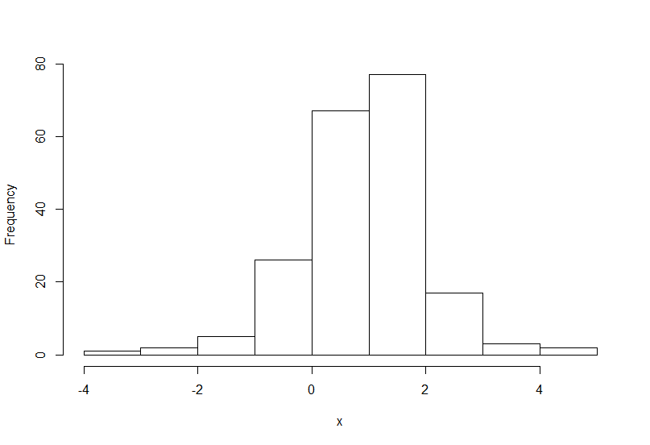

Slide 5
Two clusters one embedded within another…
And kmeans won’t do anything to help!!

Slide 6
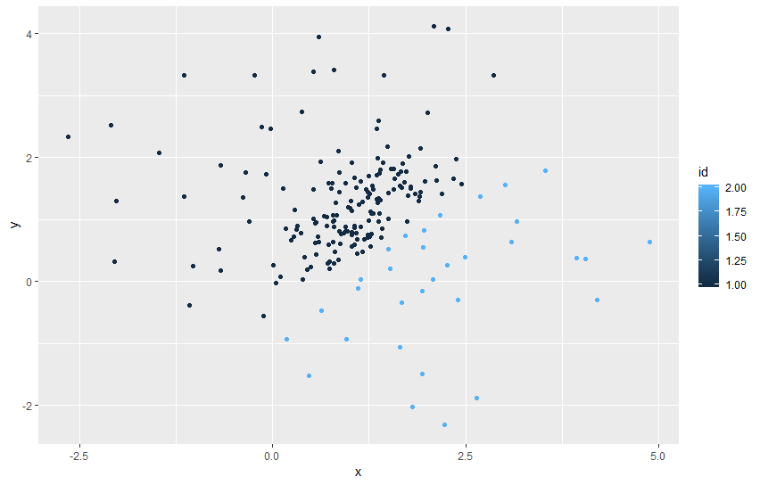
With kmeans

Slide 7
Idea: A mixture model assumes data comes from a probability distribution that has a bunch of components:
Each component represents a ‘different’ population.
Within the population there is process that generates observations.
Observations are drawn from this process.

Slide 8
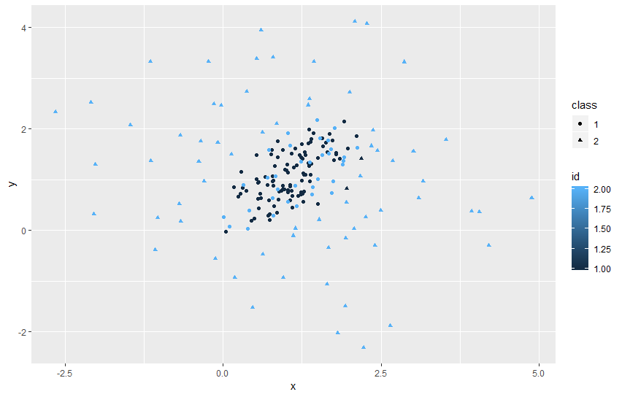
Mixture Modeling

Slide 9
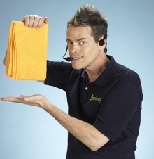
But wait there’s more…

Slide 10
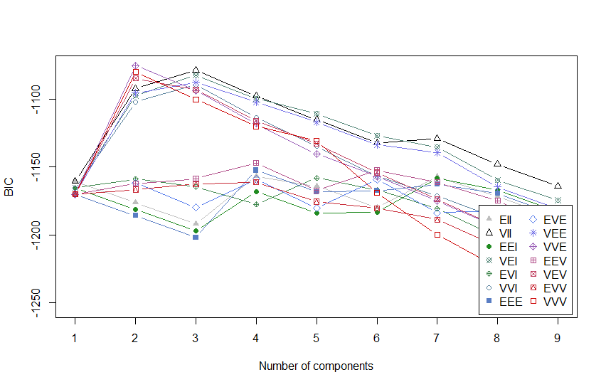
We can choose the number of components mathematically… through model selection

Slide 11
And we can automatically compute the centroids and variance …
We compute these as a form of a mixture of distributions. In this case, we compute them as a mixture of multivariate normal distributions.
So what is the Multivariate Normal distribution?

Slide 12
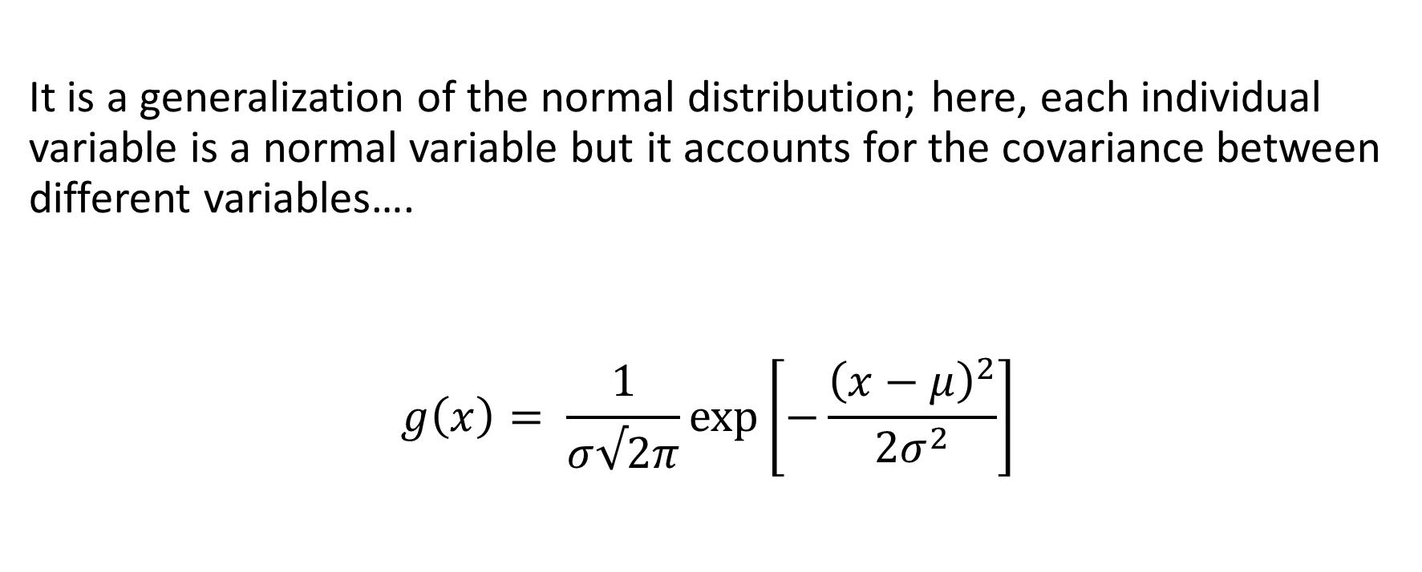
On the Multivariate normal distribution
It is a generalization of the normal distribution; here, each individual variable is a normal variable but it accounts for the covariance between different variables….
$$g\left(x\right)= \frac{1}{σ√2π}exp⁡\left[−\frac{{\left(x−μ\right)}^{2}}{2σ^{2}}\right]$$

Slide 13

A bunch of INDEPENDENT NORMALS X, Y
$$g\left(x\right)g\left(y\right)= \frac{1}{σ_{x}σ_{y}2π}exp⁡\left[−\frac{{\left(x−μ_{x}\right)}^{2}}{2σ_{x}^{2}}−\frac{{\left(y−μ_{y}\right)}^{2}}{2σ_{y}^{2}}\right]$$

Slide 14


Or in DREADED matrix form…
$$g\left(x\right)g\left(y\right)= \frac{1}{σ_{x}σ_{y}2π}exp⁡\left[−0.5{\left(\left[\begin{matrix}x \\ y\end{matrix}\right]−\left[\begin{matrix}μ_{x} \\ μ_{y}\end{matrix}\right]\right)}^{′}{\left(\begin{matrix}σ_{x}^{2} & 0 \\ 0 & σ_{y}^{2}\end{matrix}\right)}^{−1}\left(\left[\begin{matrix}x \\ y\end{matrix}\right]−\left[\begin{matrix}μ_{x} \\ μ_{y}\end{matrix}\right]\right)\right]$$
How is this related to Euclidean distance?
The inverse of the covariance matrix $Σ$

Slide 15
So really we just have a “normal distribution” that accounts for the covariance between variables.
Think about the function cov(x) in R.
This matrix determines the cigar shape of the distribution

Slide 16
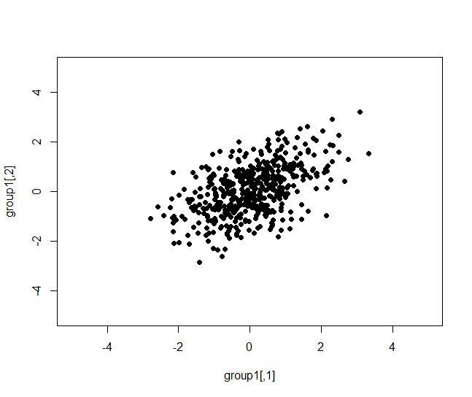
Correlation = 0.5

Slide 17
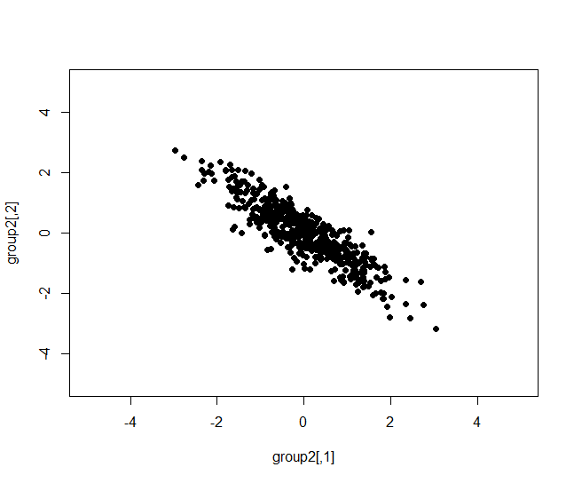
Correlation -0.9

Slide 18
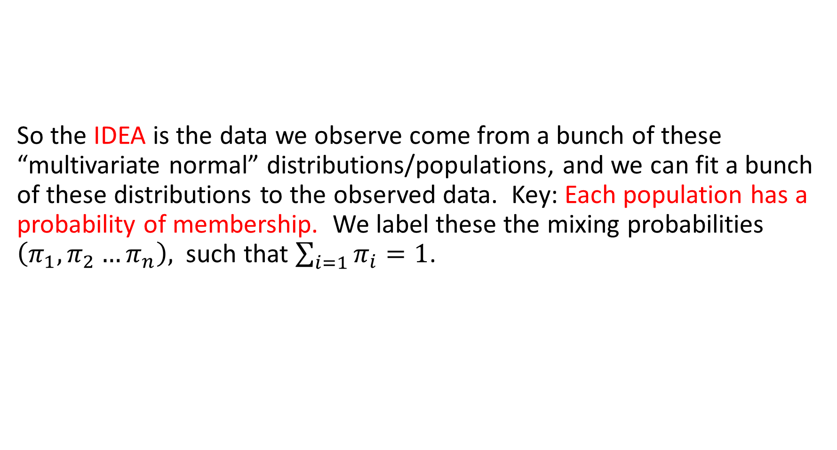
So the IDEA is the data we observe come from a bunch of these “multivariate normal” distributions/populations, and we can fit a bunch of these distributions to the observed data. Key: Each population has a probability of membership. We label these the mixing probabilities $\left(π_{1},π_{2}…π_{n}\right),$ such that $\sum_{i=1}{π_{i}}=1$.

Slide 19
Think of it this way.
I can pull out a random person from the population.
There is about a 50% chance that person is Female
There is a 50% chance that person is Male
If the person is Female, there is a distribution of heights and weights
If the person is Male, there is a DIFFERENT distribution of heights and weights.
Based solely on the (height and weight), I can guess if that person is male or female.

Slide 20

This is a mixture distribution
$$g\left(X\right)=π_{1}g_{male}\left(X | μ_{male},Σ_{male}\right)+π_{2}g_{female}(X|μ_{female},Σ_{female})$$

Slide 21
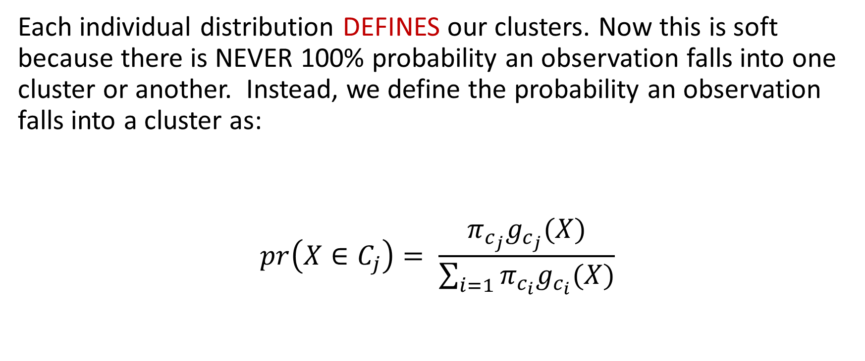
Each individual distribution DEFINES our clusters. Now this is soft because there is NEVER 100% probability an observation falls into one cluster or another. Instead, we define the probability an observation falls into a cluster as:
$$pr\left(X∈C_{j}\right)= \frac{π_{c_{j}}g_{c_{j}}(X)}{\sum_{i=1}{π_{c_{i}}g_{c_{i}}(X)}}$$

Slide 22
We then cluster based upon some THRESHOLD probability of membership.
This is totally DIFFERENT than our previous APPROACHES!
Even though ‘DISTANCE’ is defined similarly.
What is the difference in our version of EUCLIDEAN distance now and that of simple kmeans???

Slide 23
Ok let’s slow down even further…
This is the foundation of much of modern machine learning, including unsupervised learning … Latent Dirichlet Allocation (LDA)... Is just a super fancy (in)finite mixture model
Chalk Board and computer time…
Based upon what I write and questions you ask, I will update the notes accordingly.

